Slide 1
GenAI NRMA Fraud Detection Database
MVP 1
DATA TEAM
Noorullah Khan
Aasnayem Chowdhury
Alan Nguyen
Tashiya Vilathgamuwa
Ninuri Mahagoda
Notes:
Ninuri
1. Problem statement (general & subproblem) - 2 sentences
2. PM tool - why you need to manage - 2-3 sentences
Tash
3. How did we come up with the data requirements:
- you did user stories
- you talk to mentor & ai team to solidify requirements -> agile
- research the insurance industry
-> you came up with the requirements for the data (PII deleted, fraud col,..)
-> why kaggle (the biggest one)
-> we look through over /aprox 100 datasets and only 3 sources (why these one → Meet’s requirements)
-> Label column ? GPT fraud or no fraud explain better
Alan
4. solutions design
- what is the infrastructure on azure (what is the logical reasoning behind it) -> the steps
- the steps
Adam
5. cleaning - what method & why
6. enriching - what method & why
Noor
7. synthesising
8. merging
9. what is the final dataset (the diagram of the dataset is here!)
10. live demo of what the data look like
Ninuri - possibly
11. lesson learned (possibly if we havent done enough)
Alan
12. plan for next half

Slide 2
Agenda
1
Problem
6
Enriching
2
PM Tools
7
Synthesizing
3
Data Requirements
8
Merging
4
Solutions Design
9
Live Demo
5
Cleaning
10
What’s next
Notes:
Problem -> solution -> lessons (agile method) -> plan (migrate azure + refining pipeline)

Slide 3
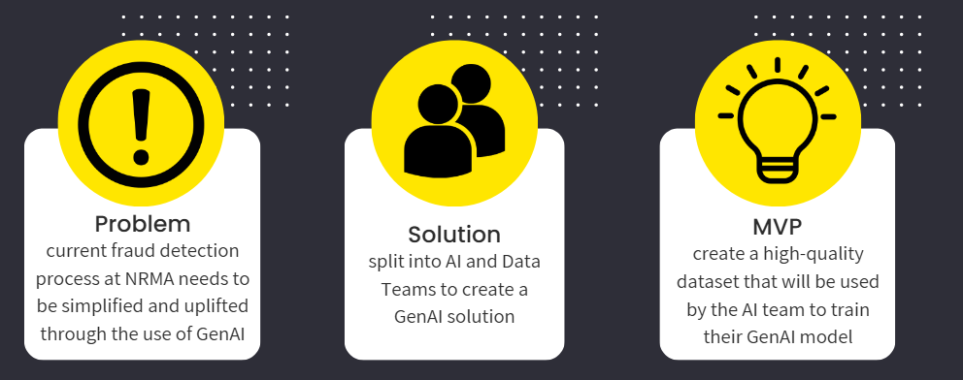
Problem Statement
Notes:
The main problem is that the current fraud detection process at NRMA needs to be simplified and uplifted through the use of GenAI. Ultimately an end-to-end GenAI solution has to be built that allows the Claims Officer to examine automobile claim reports through a user interface.
Data Team Problem
As the data team our main task at hand is to create a high quality dataset of 20,000 rows that will be used by the AI team to train their GenAI model. The main requirements for the dataset is that is should be anonymised with no PII in the dataset as well as relevant columns for the AI model

Slide 4
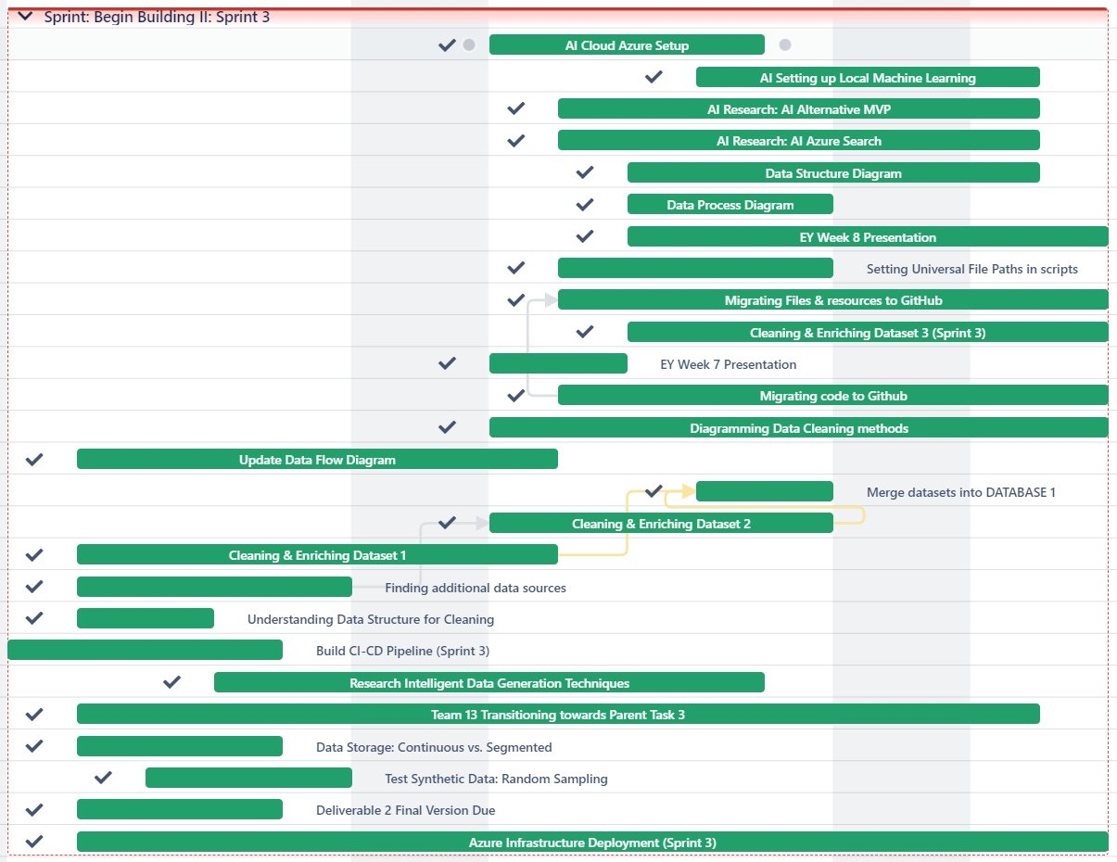
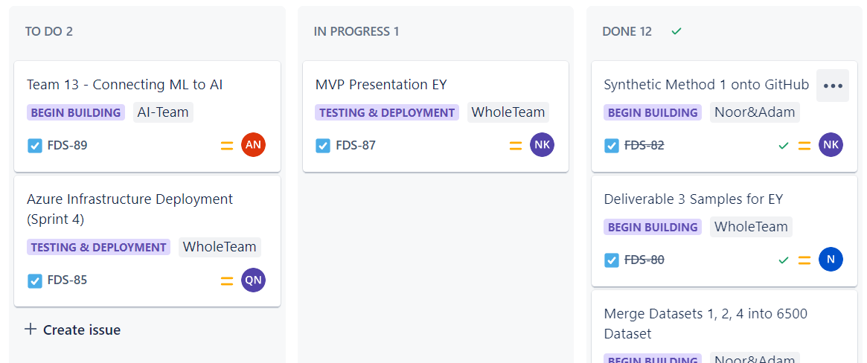
PM Tools
Customisable workflows
Collaboration with team members
Assign tasks
Create Gantt charts
Project boards & sprint backlogs
Notes:
PM tools are are integral part of this project as it allows us to organise tasks, track progress and improve collaboration within our team.
JIRA
We use Jira as our tool to manage our project for effectively as it supports agile methodology and allows us to properly track our progress and tasks.
Customisable workflows
Collaboration with team members
Assign tasks
Create Gantt charts
Create backlogs
A project management tool is essential for organizing tasks, tracking progress, and improving collaboration within a team. It helps ensure deadlines are met, resources are allocated efficiently, and communication is streamlined. Without a tool, projects can become chaotic, leading to missed deadlines, unclear responsibilities, and inefficiency.
We use JIRA for managing projects because it excels in tracking issues and tasks, supporting agile methodologies (like Scrum and Kanban), and providing robust reporting features. It allows for customizable workflows, integrates well with other tools, and offers transparency for team members to collaborate effectively.

Slide 5
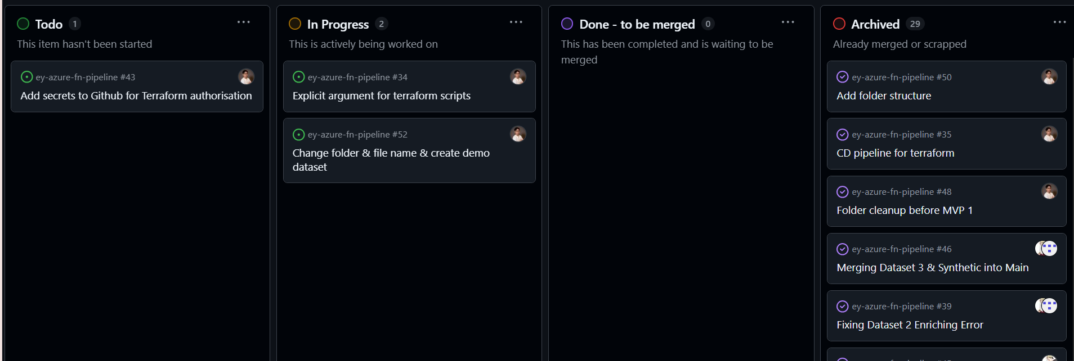
GitHub Projects
Trello board
Track task progress
Create tickets
Create branches
Collaborate with team members
Creating subtasks

Slide 6
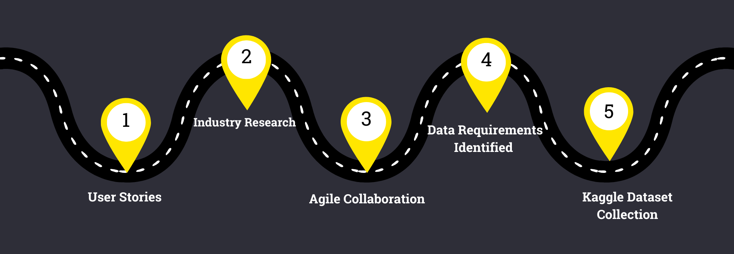
How did we develop the data requirements?

Slide 7
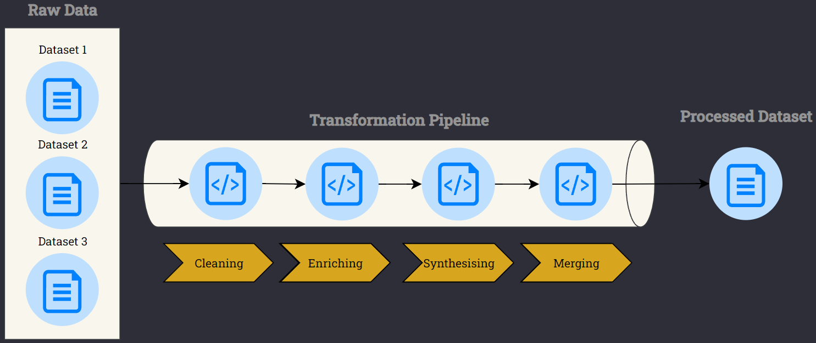
Solution Design
Notes:
- Well data is never perfect! Even with 3 promising datasets in hand, we quickly learned that the road to the perfect dataset wasn't going to as easy as we had hoped. Inconsistent column names, duplicate records, and missing values - the usual suspects were all there. So naturally, our first step is to clean each dataset individually.
But then we hit a critical point: should we synthesise or enrich first? -> back and forth -> enrich before synthesise
Had we jumped into synthesising first -> we would have been generating data from a more unrefined dataset with lots of hidden details which could have impacted the quality of the new data.
By enriching first, we added more context to build a strong foundation for the synthetic samples to capture the key features and more complex details from.
In the end, we merged everything together to produce a comprehensive dataset for the AI team to train their model.

Slide 8
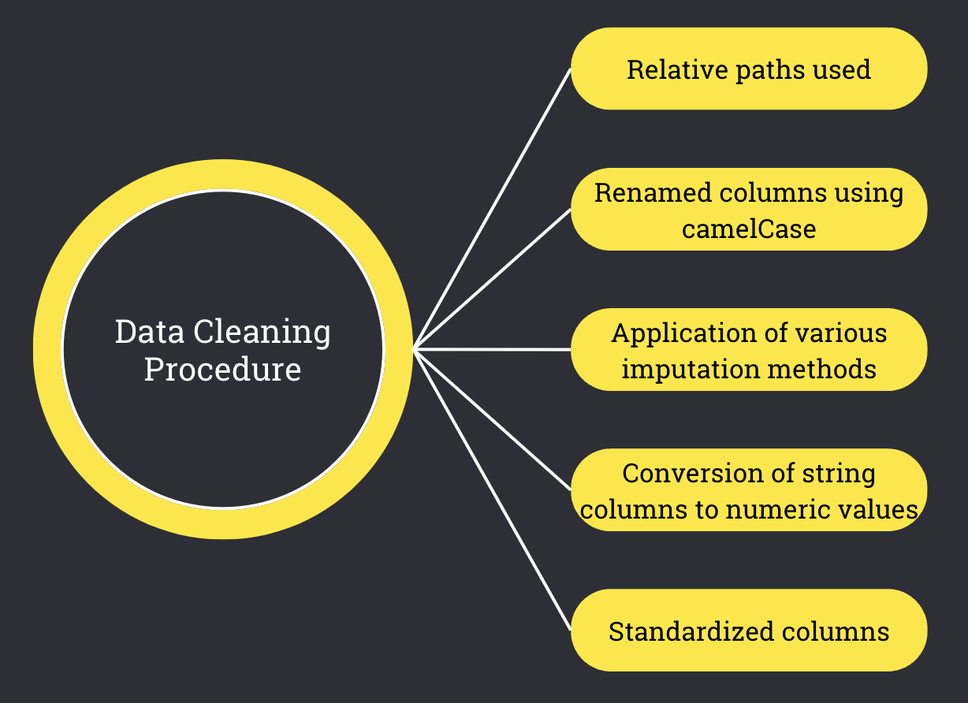
Cleaning
Notes:
Cleaning procedure:
Use of relative paths to ensure flexibility
Renamed columns using camelCase
Filling of missing values
Conversion of strings columns to numeric values.
Application of various imputation methods
Standardized columns

Slide 9
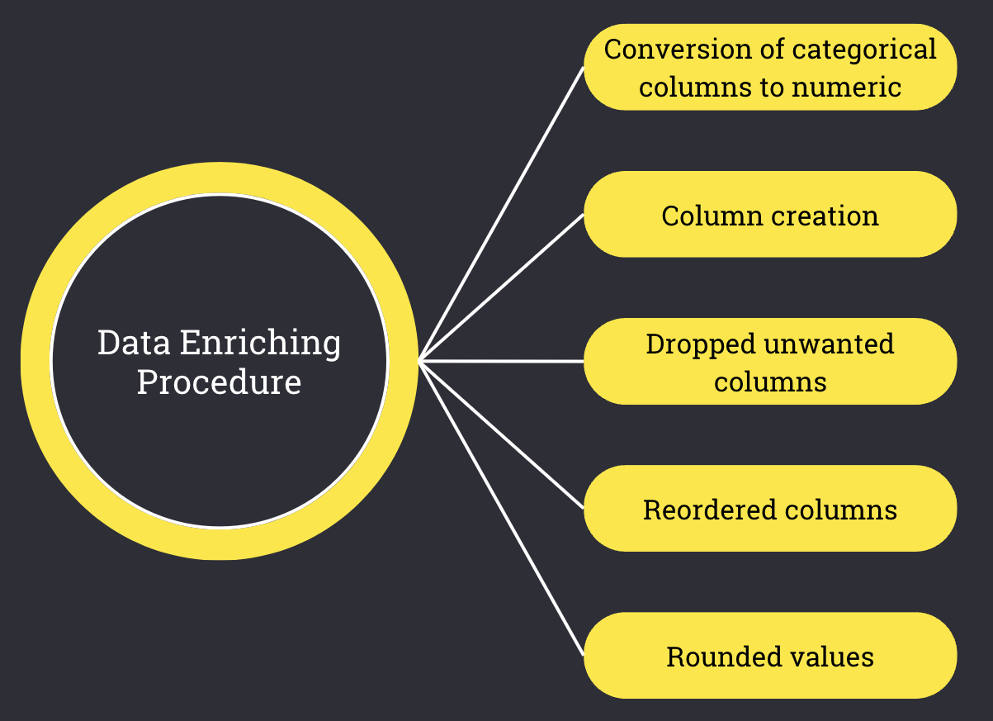
Enriching

Slide 10
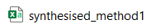
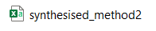
Synthesising
8000 rows total -> 38% of total dataset
Method 1: Remapping &
Mathematical Sampling
4000 rows of synthetic data
Remaps & samples data to generate rows
Preserves authenticity of Fraud column
Quick & efficient data generation
Generates data with minimal resources
Low computation cost
Method 2: CTGAN (Generative
Adversarial Network)
4000 rows of synthetic data
Advanced ML based on Neural Networks
Learns patterns & complex relationships
Captures intricate variable relationships – (`Fraud`)
Handles complex data structures efficiently
Ensures realistic, high-quality data generation.
Notes:
Synthesising - Noor
We used 2 data synthesising methods to generate a total of 8000 rows which is about 38% of the total dataset. These rows were split evenly between 2 data generation methods, each with their own unique approach.
Method 1 generated 4000 rows using remapping and mathematical sampling. This works by remapping the existing data and then applying mathematical sampling techniques to generate new rows which fit to the structure of the original data. It preserves the authenticity of the fraud column by ensuring it remains untouched by the remapping process. Method 1 also allows for quick and efficient data generation and is ideal when needing to generate data quickly with minimal resources. It has a low computational cost.
Now onto method, Method 2 which also generated 4000 rows but using CTGAN, a more advanced approach. CTGAN is a sophisticated machine learning method based on neural networks. It learns the underlying patterns and complex relationships in the data. A key strength of this method is its ability to capture intricate relationships between variables – particularly the fraud column – making it an ideal method for accurate and high-quality data generation. CTGAN is best suited for larger datasets handling complex data structures where it is critical to ensure realism i.e. generated data which can replicate the real-world patterns.

Slide 11
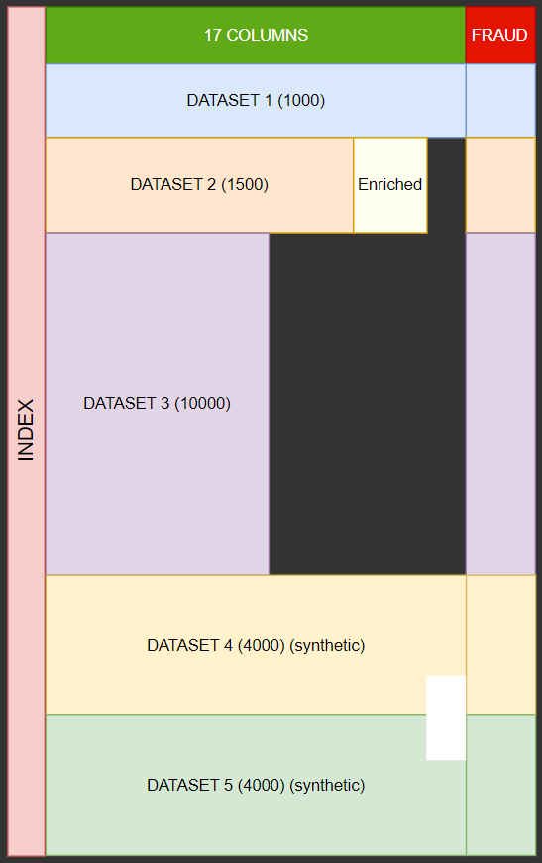

Merging
Merging Process Overview:
Combining Datasets:
3 original (cleaned & enriched) datasets:
Dataset 1 - 1,000 rows
Dataset 2 - 1,575 rows
Dataset 3 - 10,303 rows
2 synthetic datasets:
Dataset 4 - 4,000 rows (Method 1)
Dataset 5 - 4,000 rows (Method 2)
Resulted in a total of 20877 rows
Index & Fraud:
Unique identifier `index` for each row
Each row contains a `fraud` label - numerical boolean
Final Output File:
Merged dataset saved as `mergedDataset_20000.csv`
Total rows: 20,877
Ready to train AI Model
Dataset is ready for AI Team to train AI model.
Notes:
Data Merging - Noor
On the right, is a diagram of our merged dataset. During the merging process, we combined three (cleaned and enriched) original datasets and two synthetic datasets, resulting in a final dataset of over 20,000 rows, or more precisely, 20,877 rows.
This includes 1,000 rows from Dataset 1, about 1,500 rows from Dataset 2, about 10,00 rows from Dataset 3, and 4,000 rows each from the two synthetic datasets.
To maintain consistency and have a form of identifier, we assigned a unique index for each row. Each row also has a fraud label which is a numerical boolean, with 1 representing fraud and 0 representing not fraud. This fraud label is crucial for ML & AI training & testing. The merged dataset is now ready for the AI team to begin their model training.

Slide 12
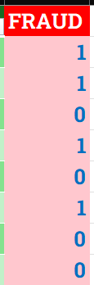
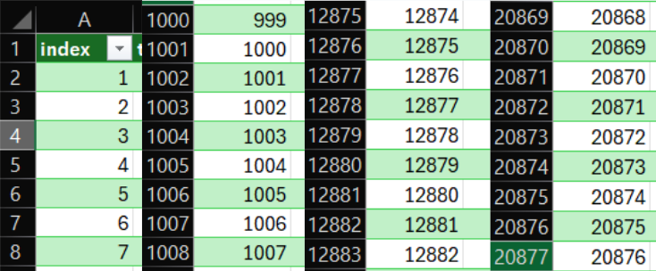
Live Demo
Merging Process Live Demo
Key Characteristics:
Total of over 20877 rows
Unique `Index` identifier for each row
Every row has a `fraud` column
Index:
Fraud:
Notes:
Live Demo - Noor
Now let’s perform a live demo of the data merger. This is our python script to load and merge our datasets.
Clicking run and we see it finished in less than a second. Now let’s open this resulting output file.
We can see it’s a large tabular database.
Some key features of this resulting dataset are:
It has about 20,800 rows and each of those rows has an index, which is like an identifier
Each row also contains a fraud column, 1 means it's fraudulent and 0 means not fraudulent. This is crucial for the AI to train and learn about fraudulent claims.

Slide 13
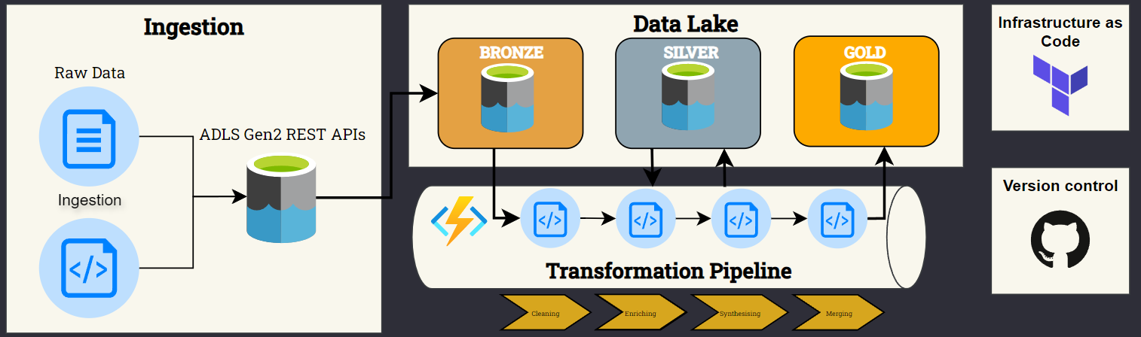
Future plan
Notes:
As we look into the future, there are 2 critical objectives that will take our solution to the next level. First, we're going to refine the pipeline even further, by testing more techniques at every step in the transformation pipeline to ensure our data is clean, accurate and ready for action.
But that's only half the story. Our second focus is to deploy this entire pipeline on Azure.
For this design, we're implementing a medallion architecture for our DATA LAKE, which abstracts our data into 3 layers
We start by ingesting raw data into the Bronze layer, which acts as our main reference point.
For each step in the transformation pipeline, we temporarily store the data in the silve layer, or as we call it, a staging silo.
Once the data is fully processed, it moves to the gold layer, where it is ready for use. And all the scripts we've developed will be hosted on Azure Functions, which offers great scalability at minimal cost and management effort.
One of the first step we have taken is to define the infrastructure on Azure, using Terraform.
Traditionally, setting things up on Azure involves numerous options & configuations which is prone to human error.
By using IaC, your technical team will have a clearer understanding of the infrastructure, making it easier to recreate and manage the pipeline.

Slide 14
Thank You
Notes:
Here's the bottom line: we've built a pipeline prototype that works well on a small scale locally. Now, by refining the process and deploying it on Azure, we hope to build a solution that will bring real and lasting values to you. And that concludes our presentation, please ask your questions!

